Slide 1

Electronics and Computer Technology Department
Design and Development of Project FALCON: A Solar-Powered Smart Buoy for Wave, Wind-Speed, and Wind-Direction Monitoring with Short-Term Wave-Height Prediction
A Thesis Proposal
PROPONENTS
John Ruzzel M. Correa • Mayla R. Bacaltos • Gina P. Caballero
Saira B. Caballero • Gwyn Isabel C. Enriquez
Adviser: Engr. Jeff Gabayno, ECE
October 2026
Notes:
Good day, panel. We are presenting Project FALCON, a solar-powered smart buoy for wave, wind-speed, and wind-direction monitoring with short-term wave-height prediction. This is a proposal defense; the system has not yet been field-validated.

Slide 2
Introduction
Project FALCON is a proposed solar-powered smart buoy system designed for coastal environmental monitoring.
Integrates pressure-based wave-height estimation, wind-speed, and wind-direction monitoring.
Uses GPS tracking and IoT-based cloud monitoring for remote data access.
Incorporates AI-assisted short-term wave-height prediction.
Aims to design, develop, and evaluate an integrated monitoring system in Puerto Princesa City, Palawan.
1
Notes:
Frame the problem: information is scarce where it is most needed. FALCON is an integration and evaluation project, not an invention of new sensors.

Slide 3
Background of the Study
Pressure sensing - a submerged 4–20 mA transmitter records water pressure for pressure-derived wave-height estimation.
Wind sensing - a cup anemometer and wind vane record wind speed and 0°–360° wind direction.
ESP32 controller - samples, timestamps, filters, buffers locally, and prepares a two-minute summary packet.
Position and power - GPS/GNSS for location, drift, geofence, and recovery; solar-battery monitoring for operating status.
Connectivity - Wi-Fi for bench and near-shore work; LTE as a conditional field option.
Prediction - a 15-minute-ahead model compared with persistence and damped linear-trend baselines.
2
Notes:
Introduce the system at a high level. Stress that only the ESP32 is confirmed; the rest are proposed or candidate parts pending validation.

Slide 4
National Context
In the Philippines, coastal communities are exposed to changing wave and weather conditions that can affect marine activities and coastal safety.
Pacaldo, Bilgera, and Abundo (2022) studied nearshore wave-energy resources in Cuyo Island, Palawan, highlighting variations in wave conditions.
Esteban et al. (2023) examined the effects of Typhoon Odette, including storm surges, strong winds, and wind-driven waves in Cebu and Bohol.
The DOST-ASTI METBUOY project demonstrates the use of sensors for monitoring wave height, wave period, wind speed, and wind direction.
PAGASA provides marine weather analysis and wave forecasts to support maritime safety and monitoring.
These initiatives provide a basis for developing Project FALCON, which integrates wave and wind monitoring with solar power, cloud-based data presentation, and short-term wave-height prediction.
3
Notes:
Show local relevance and acknowledge existing government capability. Position FALCON as complementary, not competing.

Slide 5
Local Context
Dangan-Galon et al. (2016); Dulohan et al. (2022) — mangrove diversity and cover change in Puerto Princesa Bay.
Sumeldan et al. (2021) — community perceptions of marine environmental quality in Palawan.
Alcantara et al. (2023); Madarcos et al. (2026) — climate-change awareness and perceived coastal changes.
Local studies establish the value of environmental information but do not provide instrument-based wave and wind records.
FALCON will add instrument-based wave, wind, and position records for the same coastal area.
4
Notes:
Be precise: perceptions are not measurements. This distinction motivates the instrument-based approach.

Slide 6
Review of Related Literature
Pressure-Based Wave Measurement
Pressure-based wave measurement estimates wave characteristics through underwater pressure changes detected by submerged sensors.
Collins et al. (2026) discussed different ocean wave measurement technologies, including pressure sensors, acoustic instruments, wave buoys, and radar.
Pressure readings are affected by atmospheric pressure, water density, sensor depth, and water movement.
Accurate measurements require proper sensor installation, stable reference depth, appropriate sampling rate, and calibration.
Project FALCON Application: Uses an underwater pressure transmitter to collect and process pressure readings to estimate wave height and evaluate measurement consistency.
5
Notes:
Explain the measurement principle and the installation requirement. This is the technical heart of the buoy.

Slide 7
Review of Related Literature
Solar-Powered Monitoring System
Solar-powered systems use sunlight to supply electricity to electronic devices, making them suitable for remote marine monitoring.
González-Reolid et al. (2018) demonstrated the use of solar panels and rechargeable batteries in an autonomous marine observatory.
Jabbar et al. (2024) integrated solar energy, IoT sensors, and LoRaWAN for remote water-quality monitoring.
Reliable operation depends on solar availability, battery capacity, power consumption, and proper energy management.
Project FALCON Application: Uses six 5W solar panels (30W total), a 12.8V 8Ah LiFePO4 battery (102.4Wh), charge controller, BMS, fuses, and regulated power supply.
6
Notes:
Connect power design to the actual load, and explain why local buffering is part of the IoT architecture.

Slide 8
Review of Related Literature
AI-Assisted Short-Term Wave-Height Prediction
AI and machine-learning methods analyze historical environmental data to identify patterns and predict future wave-height conditions.
Wind speed and wind direction can serve as additional variables to improve wave-height prediction.
Project FALCON Application: Uses recent validated wave-height observations, wind speed, and 0°–360° wind direction to generate 15-minute-ahead wave-height predictions.
Prediction performance will be compared against observed wave heights using persistence and damped linear-trend forecasting methods.
Model accuracy will be evaluated using MAE, RMSE, and MBE.
Predictions are intended for prototype evaluation and research, not as official marine forecasts or safety warnings.
7
Notes:
Avoid claiming accuracy. The proposal evaluates whether the model improves on persistence and a damped trend.

Slide 9
Synthesis and Research Gap
Existing studies establish the use of pressure sensors, solar energy, IoT-cloud platforms, and AI for environmental monitoring.
However, these technologies are often studied separately rather than integrated into one monitoring prototype.
Research Gap: Limited integration and evaluation of these technologies in a locally maintainable smart-buoy system.
Project FALCON: Integrates wave and wind monitoring, GPS, solar power, cloud storage, wireless communication, and AI-assisted 15-minute-ahead wave-height prediction.
Prediction performance will be evaluated using MAE, RMSE, and MBE against simpler forecasting methods.
8
Notes:
Avoid claiming accuracy. The proposal evaluates whether the model improves on persistence and a damped trend.

Slide 10
Review of Related Studies
INTERNATIONAL
Bethel et al. (2022) — LSTM forecasting of hurricane-forced significant wave heights in the Caribbean Sea.
Xiao and Lu (2024) — a Conformer–LSTM hybrid evaluated with MAE, RMSE, MAPE, and R².
Yang et al. (2025) — LightGBM and TCN-BiGRU for maximum wave height using buoy observations.
These studies support using historical wave observations and wind-related variables as model inputs.
FALCON applies the same principle to a low-cost local buoy and reports results against transparent baselines.
9
Notes:
Highlight the evaluation metrics and the use of buoy data, not the specific model architectures.

Slide 11
Theoretical and Conceptual Framework
THREE COMPLEMENTARY LENSES
ICCF — Halba et al. (2021): IoT and cyber-physical capabilities must interact and be verified as one system.
AIoT — Seng, Ang, and Ngharamike (2022): sensing, communication, computing, and AI are connected functions, not separate technologies.
Capability composition — Griffor et al. (2023): each capability can be tested separately and then evaluated as an integrated service.
Together, the frameworks justify testing both individual subsystems and the prototype as a whole.
They also define the evaluation areas: measurement, communication, power, data integrity, dashboard, and prediction.
10
Notes:
Explain why three frameworks: one for integration, one for intelligence, one for decomposition and testing.

Slide 12
Conceptual Paradigm
INPUT–PROCESS–OUTPUT WITH VALIDATION
INPUT
PROCESS
OUTPUT
Water-pressure data
Wind speed and 0°–360° direction
GPS location
Solar and battery status
System and site requirements
Sensor data acquisition
Calibration and filtering
Pressure-to-wave-height estimation
Wireless upload and storage
Dashboard display and forecasting
Estimated wave height
Wind speed and direction
GPS and system status
Cloud monitoring records
Prediction and performance results
VALIDATION & FEEDBACK • reference comparison • power • transmission • usability • redesign
11
Notes:
Read the three columns and stress the feedback loop: test results feed design improvement.

Slide 13
Scope of the Study
Development and evaluation of Project FALCON, a solar-powered smart buoy for wave and wind monitoring.
Integrates pressure, wind-speed, wind-direction, GPS/GNSS, and ESP32 sensors and components.
Uses solar-battery power, local data storage, wireless communication, and cloud-based monitoring.
Transmits environmental data every 2 minutes and provides authorized and public dashboard views.
Generates 15-minute-ahead wave-height predictions using approximately one month of wave and wind data.
Evaluates sensor accuracy, communication reliability, data integrity, GPS performance, power efficiency, dashboard usability, and prediction performance.
12
Notes:
Keep the claims modest: the system supports awareness and research; it is not an official warning service.

Slide 14
Delimitations of the Study
Testing will be conducted in Puerto Princesa City, Palawan through bench testing, controlled water testing, and limited near-shore validation, subject to safety, permission, and site suitability.
Pressure-based wave-height estimates require calibration, reference comparison, and full sensor submersion within the 5-meter measurement range.
Wave period and certified significant wave height are not included in the study.
Testing is limited to calm to moderate sea conditions, excluding storms, typhoons, and hazardous weather.
Long-term marine reliability is not covered by the evaluation.
Wave-height predictions are limited to 15 minutes ahead and depend on data quality and environmental conditions.
Project FALCON is a research prototype and does not replace official forecasts, navigation instruments, or safety warning systems
Personal data collection and handling will comply with the Data Privacy Act of 2012 (RA 10173).
13
Notes:
Keep the claims modest: the system supports awareness and research; it is not an official warning service.

Slide 15
Significance of the Study
WHO BENEFITS
DOST — a reference for integrating IoT, renewable energy, and AI in coastal monitoring.
Coastal residents and fisherfolk — additional wave and wind information for awareness and planning.
Barangays and local government offices — supplementary environmental data for local planning.
Philippine Coast Guard — supplementary coastal observation, not a replacement for official advisories.
Future researchers — a documented architecture, data process, and evaluation method for similar buoys.
14
Notes:
Keep the claims modest: the system supports awareness and research; it is not an official warning service.

Slide 16
Statement of the Problem
The study aims to design, develop, and evaluate a solar-powered smart buoy for wave, wind-speed, and 0°–360° wind-direction monitoring with transparent short-term wave-height forecasting.
1. How can FALCON be designed and developed as an integrated buoy combining pressure-based wave estimation, wind sensing, GPS, ESP32 acquisition, solar power, wireless transmission, and cloud monitoring?
2. How does it perform in wave-height estimation, wind speed and direction, transmission and storage, GPS tracking, and solar-battery operation under the selected test conditions?
3. How accurately can the forecasting component generate 15-minute-ahead wave-height predictions compared with persistence and damped linear-trend baselines?
4. How functional and usable is the cloud-based dashboard in presenting wave, wind, GPS, power, and prediction information?
15
Notes:
Read the main objective, then summarize the four questions. Note the scope: bench, controlled water, and limited near-shore validation.

Slide 17
Methodology
This chapter presents the methods and procedures that will be used in the development and evaluation of Project FALCON. It focuses on the design, construction, integration, and testing of a solar-powered smart buoy for monitoring wave height, wind speed, and wind direction, including short-term wave-height prediction.
The study will use a Developmental Research Design supported by quantitative data collection and qualitative feedback to evaluate the system's performance and functionality.
16
Notes:
Explain that the prototype is refined between stages, not tested once at the end.

Slide 18
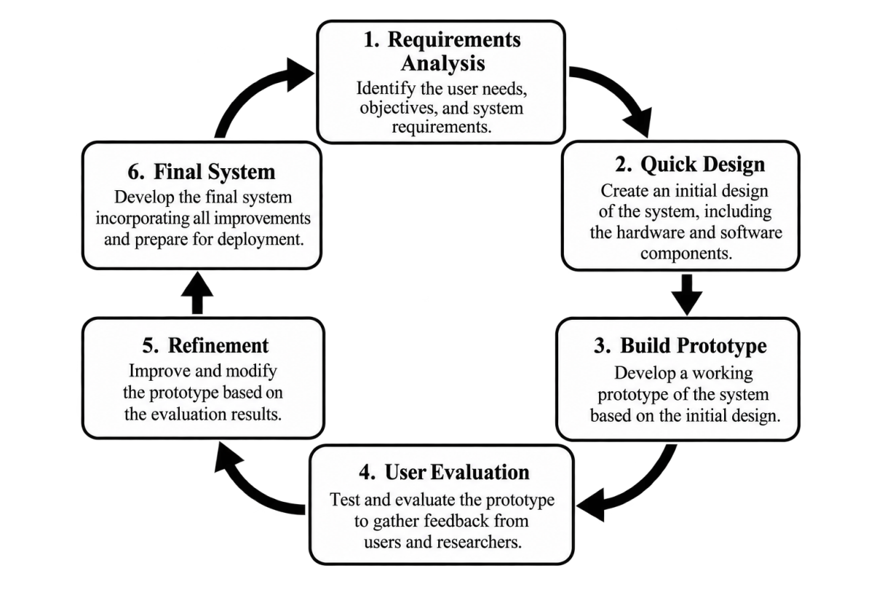
Research Design / Project Development Methodology
ITERATIVE PROTOTYPING
Requirements define sensors, power, communication, storage, and dashboard needs.
Quick design produces the block diagram, architecture, data flow, and layout.
Build and evaluate the first working prototype.
Refine based on test results, then document the final configuration.
Issues are corrected before the next testing stage.
Figure 2.1.1 System Development Life Cycle (Prototyping Model)
17
Notes:
The model is iterative: each loop produces a working output that is checked and improved.

Slide 19
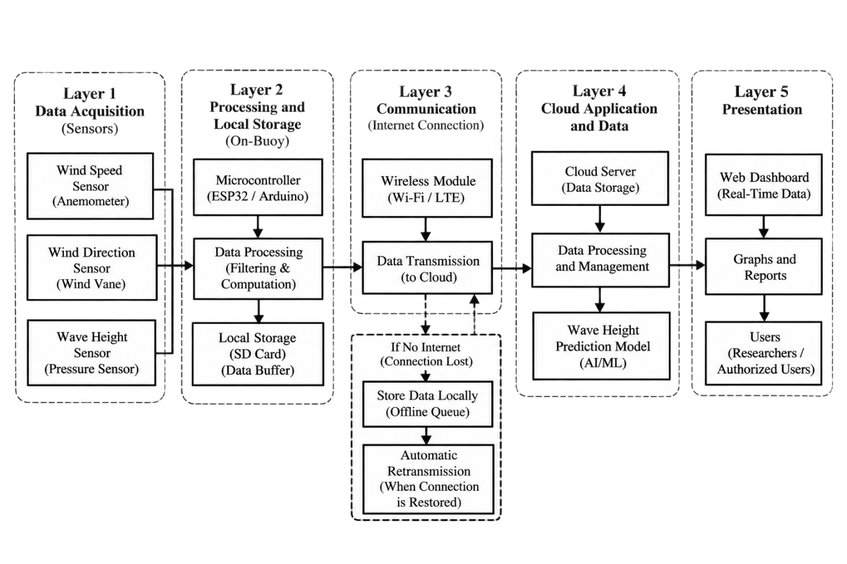
System Architecture / Framework: SYSTEM OVERVIEW
FIVE FUNCTIONAL LAYERS
Acquisition: pressure, wind, GPS, and power inputs.
Processing and storage: ESP32 sampling, timestamps, filtering, and local queue.
Communication: Wi-Fi or LTE upload of the two-minute summary.
Cloud: storage, prediction, and dashboard API.
Presentation: authorized dashboard and a separate public map view.
Figure 2.2.2 Project FALCON System Overview
18
Notes:
Walk through the five layers and emphasize what happens when connectivity is lost.

Slide 20
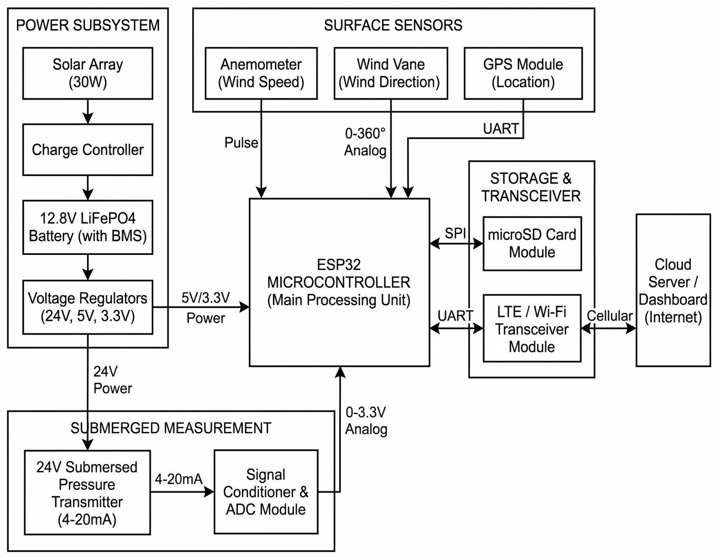
System Design and Architecture
HARDWARE BLOCK DIAGRAM
ESP32 is the main controller; only the ESP32 is confirmed for procurement.
Pressure transmitter: 24 V, 4–20 mA, with a signal-conditioning and ADC interface.
Wind speed and direction, GPS, microSD storage, and Wi-Fi/LTE communication.
Power: solar array, LiFePO4 charge controller, 12.8 V 8 Ah battery, and regulated rails.
The pressure sensor is fixed to a seabed frame; a separate mooring line holds the buoy.
Figure 2.2.3 Project FALCON Hardware Block Diagram
19
Notes:
State clearly that all blocks except the ESP32 remain proposed or candidate parts pending validation. The 30 W solar label is the proposal's nominal figure; panel wattage and the 3S2P wiring still require verification.

Slide 21
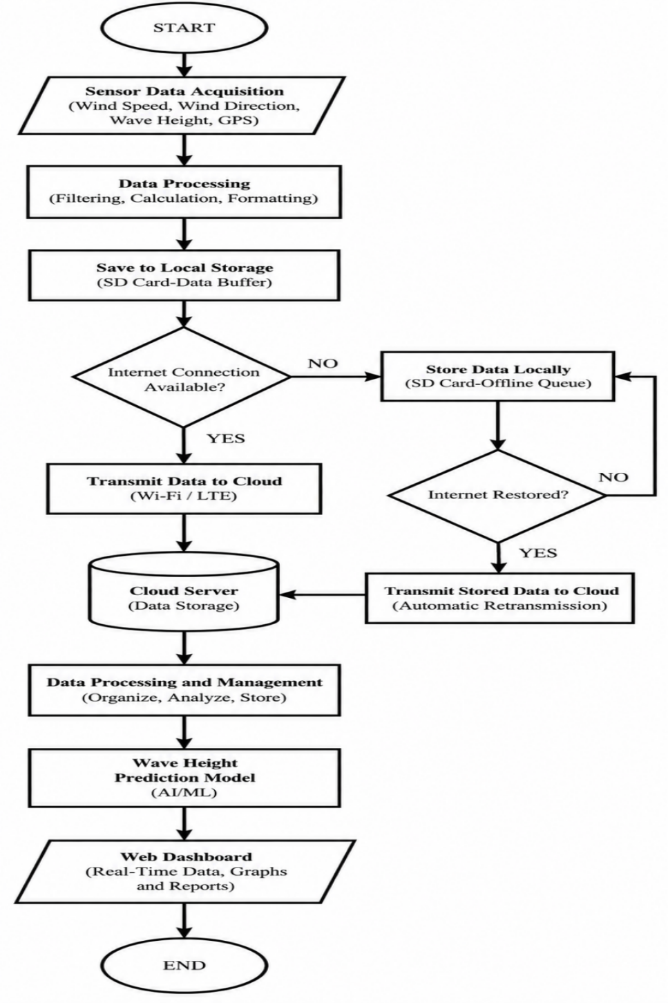
System Flowchart
Acquire pressure, wind, GPS, and power data; timestamp and process each record.
Store raw samples locally and prepare a two-minute summary packet.
If connectivity is available, upload the summary and any queued records.
If connectivity is lost, keep sensing and queue records with original timestamps.
After recovery, transmit queued records before resuming scheduled uploads.
The process is continuous; it does not stop after one dashboard update.
Figure 2.2.4 Project FALCON System Flowchart
20
Notes:
Point out that the flowchart is continuous; the queue prevents data loss during outages.

Slide 22
Data Collection Methods
FIVE DATA GROUPS
Data Collection Activity | Sensor or module | Output or action
Water pressure | Submerged 4–20 mA transmitter and ESP32 | Timestamped raw pressure samples retained for wave analysis
Wind observation | Cup anemometer and wind vane | Wind speed and 0°–360° direction summarized per window
Position and status | GPS/GNSS receiver and ESP32 | Position, time, geofence status, and device health
Power monitoring | LiFePO4 battery, charge controller, panels, power monitor | Voltage, current, charging status, and quality flags
Scheduled transmission | Wi-Fi or LTE module and cloud service | One summary packet every two minutes; queued records recovered after outage
Bench Testing – Checks sensor connections, calibration, timestamps, data storage, and communication.
Controlled Water Testing – Tests the pressure sensor using a measured water column or controlled water movement.
Limited Near-Shore Validation – Compares buoy measurements with reference readings under approved and supervised conditions.
21
Notes:
Explain the two-minute summary packet and the retained raw pressure samples for recalculation.

Slide 23
Software and Tools Used: Software Tools
C++ (Arduino Framework / PlatformIO)
Python 3.11
React 19, TypeScript, and Vite
SQLite
Leaflet
AI-Assisted 15-Minute Wave-Height Prediction Module
22
Notes:
Match the tools to the functions they support. Mention that the dashboard is already prototyped.

Slide 24
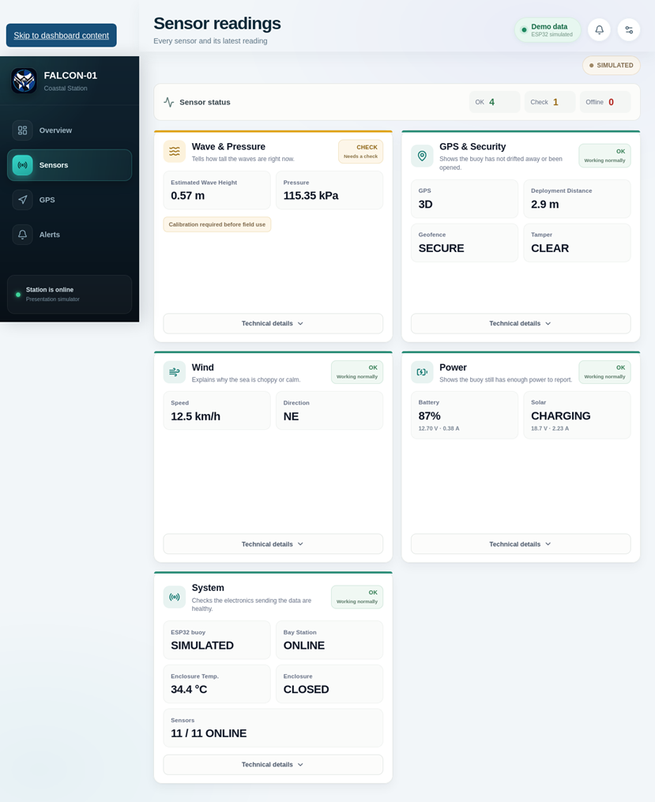
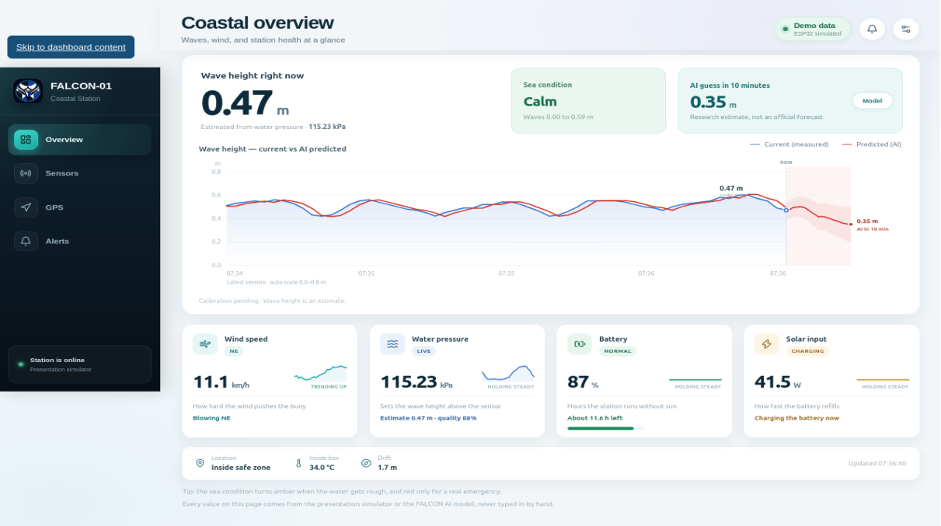
Dashboard and User Interface Design
Figure 2.5.1 Dashboard Overview
Figure 2.5.2 Sensor Readings Interface
23
Notes:
The screenshots are from the working dashboard prototype and are labeled as simulation data.

Slide 25
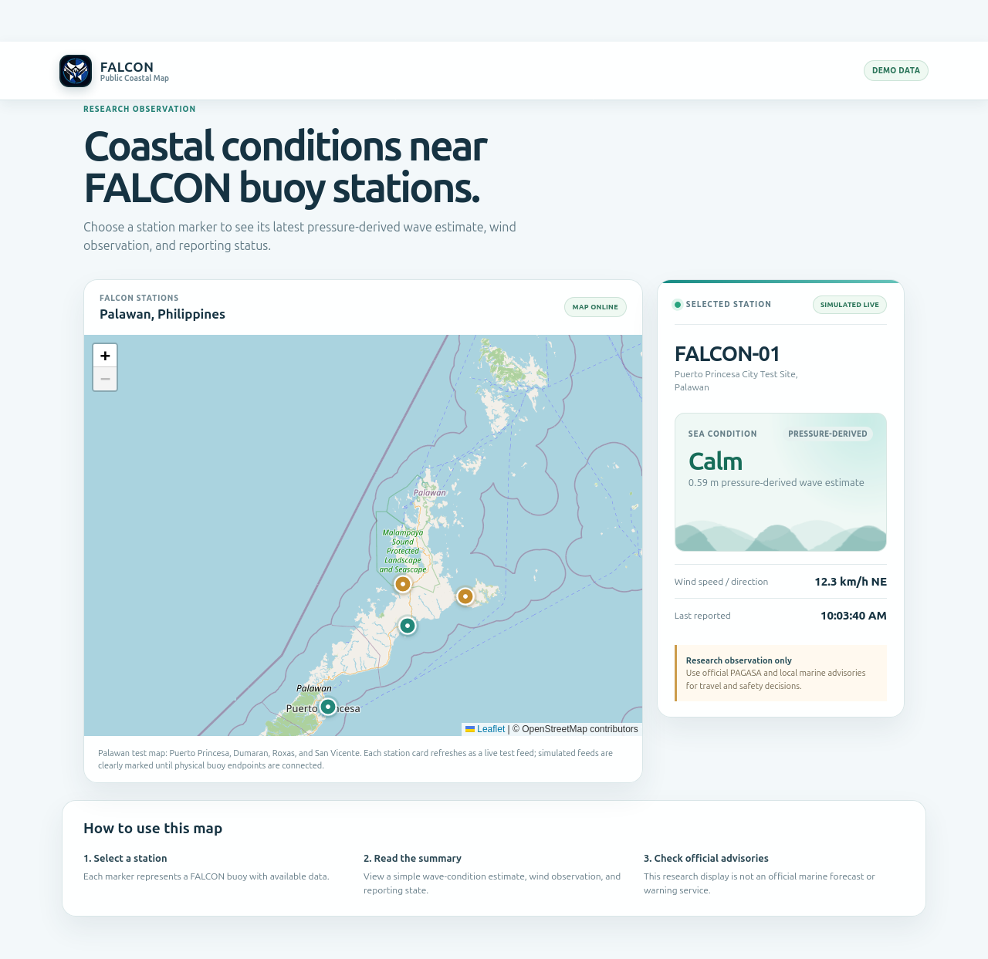
Public User Dashboard
A separate, read-only view for public monitoring.
Shows the Palawan map with buoy station markers.
Selecting a station shows wave condition, wind, reporting state, and last update.
Raw records, controls, security settings, and maintenance functions remain restricted.
The public view supplements awareness; it is not an official advisory service.
Figure 2.5.6 Public User Dashboard – Palawan Buoy Map and Selected Station
24
Notes:
Explain the separation between operator and public views.

Slide 26
Testing and Evaluation
Parameter | Metric or target | Method
Wave-height estimate | MAE, RMSE, MBE | Paired values against an independent reference
Wind speed | MAE | Paired readings against a reference anemometer
Wind direction | Mean angular error | Smallest 0°–360° angular difference
GPS location | Coordinate and distance error | Comparison with a trusted position
Transmission | PDR ≥ 98% during testing | Received ÷ sent packets × 100%
Data integrity | No loss of valid records or timestamps | Compare expected, stored, and received records
Power | Voltage, current, energy, runtime | Measured charge and discharge behavior
Prediction | MAE, RMSE, MBE | AI, persistence, and damped trend on the same test data
Dashboard | Functional check and usability feedback | Task-based evaluation form
25
Notes:
Highlight the only numeric target in the proposal: PDR of at least 98%. Other thresholds are to be established.

Slide 27
AI-Assisted Prediction Testing
EVALUATION DESIGN
Use approximately one month of validated two-minute records.
Align records on a consistent time grid; the target is the observation 15 minutes later.
Split chronologically into training, validation, and held-out testing portions.
Do not use future observations to train or tune the model.
Compare the model with persistence and a damped linear-trend baseline.
Report MAE, RMSE, and MBE; no accuracy claim is made without held-out results.
26
Notes:
The persistence baseline uses the latest observation; the damped trend uses recent changes with a reduced trend effect.

Slide 28
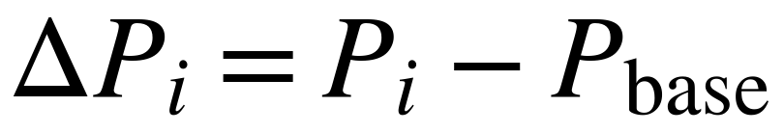
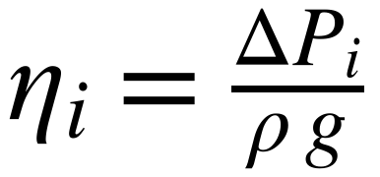
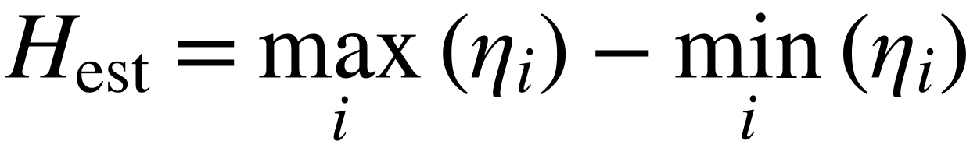
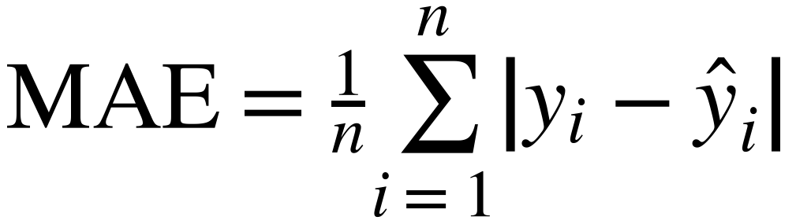
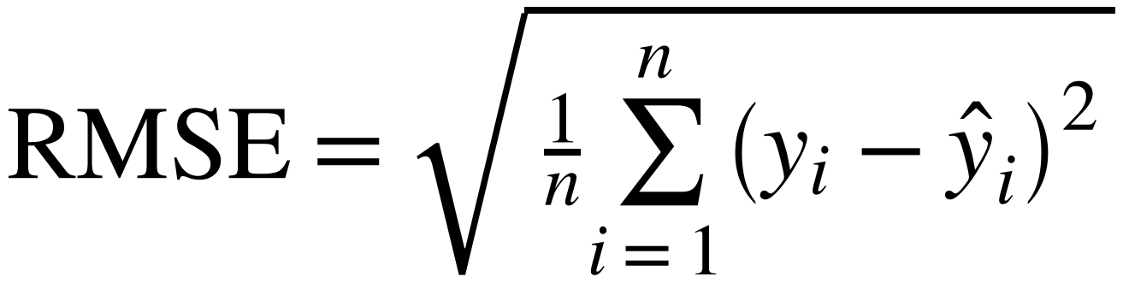
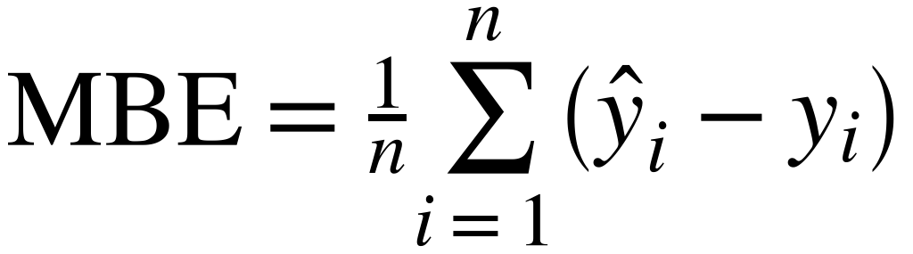

Statistical Treatment of Data
MEASUREMENT ACCURACY AND RELIABILITY
Pressure-Derived Wave-Height Computation
ΔPi = Pi − Pbase = pressure difference at sample i
Pi = pressure at sample i · Pbase = baseline pressure
ρ = seawater density · g = gravitational acceleration
ηi = water-level displacement · Hest = estimated wave height
Mean Absolute Error (MAE)
Root Mean Square Error (RMSE)
yi = reference measurement · ŷi = FALCON measurement · n = paired measurements
yi = reference measurement · ŷi = FALCON measurement · n = paired measurements
Mean Bias Error (MBE)
Packet Delivery Ratio (PDR)
ŷi − yi: positive MBE = overestimation · negative = underestimation · n = paired measurements
Nreceived = original packets received · Nsent = original packets transmitted · target: PDR ≥ 98%
27
Notes:
Walk through the measurement equations first: the pressure difference gives the water-level displacement, and the difference between the maximum and minimum displacement gives the estimated wave height. MAE, RMSE and MBE compare the FALCON estimate (y-hat) with the reference measurement (y). PDR measures how many original packets reached the cloud service.

Slide 29
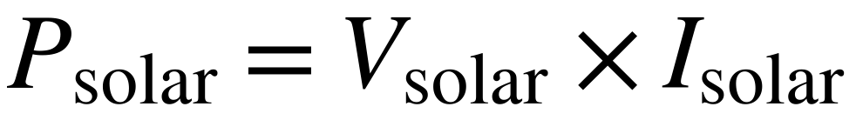

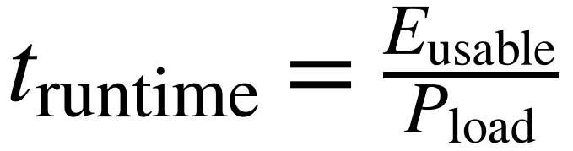
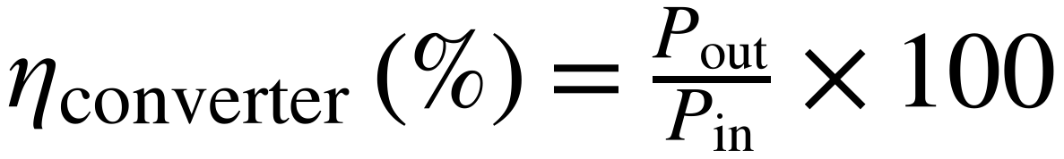
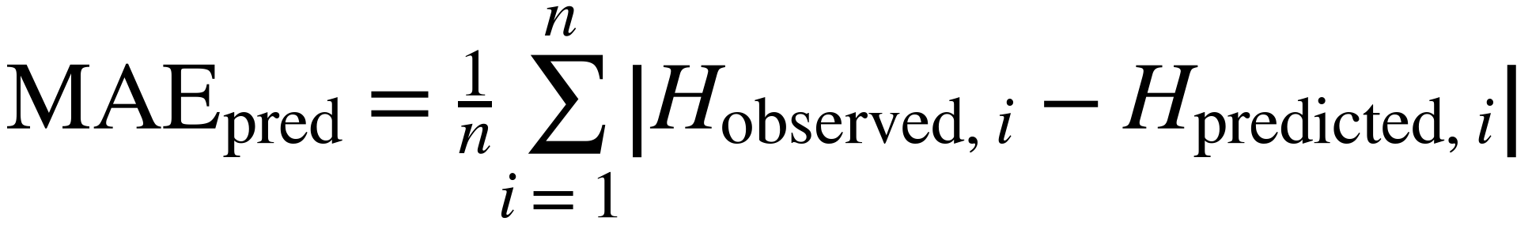
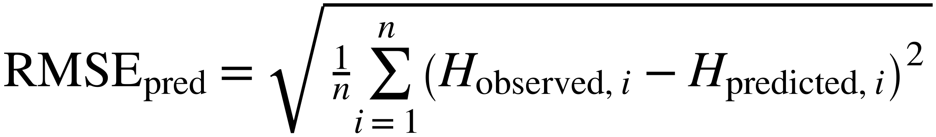
Statistical Treatment of Data (2 of 2)
POWER AND PREDICTION ACCURACY
Measured Solar Power
Battery Stored Energy
Psolar = measured solar power (W) · Vsolar = voltage (V) · Isolar = current (A)
Ebattery = nominal energy (Wh) · Vbattery = nominal voltage (V) · Ahbattery = battery capacity
Estimated Battery Runtime
DC–DC Converter Efficiency
truntime = runtime (h) · Eusable = usable energy (Wh) · Pload = average system load (W)
ηconverter = converter efficiency (%) · Pout = output power · Pin = input power
Prediction Mean Absolute Error
Prediction Root Mean Square Error
Hobserved,i = observed height · Hpredicted,i = predicted height · n = paired predictions
Hobserved,i = observed height · Hpredicted,i = predicted height · n = paired predictions
28
Notes:
Cover the power equations and the prediction metrics. Solar power is voltage times current; stored energy is battery voltage times capacity; runtime is usable energy divided by the average load. Prediction MAE and RMSE are computed on the same chronologically held-out records used for the persistence and damped-trend baselines.

Slide 30
Ethical Considerations
RESPONSIBLE CONDUCT
Participation is voluntary and based on an informed-consent form in clear language.
Collect only necessary data; separate identifiers from responses and use codes.
Limit access to the research team and adviser; use controlled and encrypted storage where available.
Follow a written safety and retrieval plan; no deployment in severe weather or navigation channels.
Label dashboard data as experimental, stale, simulated, calibration-required, or unavailable.
Report unsuccessful tests and limitations; FALCON is not an official warning or navigation instrument.
29
Notes:
Mention the Data Privacy Act and the one-year retention period after the final defense.

Slide 31
References
SELECTED SOURCES (1 OF 2)
Alcantara, L. B., et al. (2023). Climate change awareness and risk perceptions in Palawan. UCL Open Environment, 5, e054.
Bethel, B. J., Sun, W., Dong, C., & Wang, D. (2022). Forecasting hurricane-forced significant wave heights using an LSTM network. Ocean Science, 18, 419–436.
Bullecer, B. A. S., Jabao, C. J. S., & Yahya, A. (2025). Remote water quality monitoring using solar-powered long-range communication. Mindanao Journal of Science and Technology, 23(2), 286–310.
Collins, C. O., III, et al. (2026). Measuring ocean surface waves. Reviews of Geophysics, 64(3), e2025RG000888.
Dabu, R. E. (2025). Storm tide and wave-induced hazards in Cagayan Coastal Boulevard. Critical Insights in Climate Change, 1(1), 2493964.
Dangan-Galon, F., et al. (2016). Mangrove diversity along Puerto Princesa Bay, Palawan. Journal of Marine and Island Cultures, 5(2), 118–125.
Department of Science and Technology–ASTI. (2024). 2024 annual report.
Dulohan, C. L., et al. (2022). Mangrove forest cover changes in Puerto Princesa Bay, 1999–2020. SPP-2022-PB-02.
Ebron, J. G. (2025). IoT multi-sensor and deep learning system for real-time water quality forecasting. Chemical Engineering Transactions, 122, 439–444.
Esteban, M., et al. (2023). Field survey of 2021 Typhoon Rai–Odette in the Philippines. Journal of Coastal and Riverine Flood Risk, 1, Article 1.
González-Reolid, I., et al. (2018). Autonomous solar-powered marine robotic observatory for shallow water. Sensors, 18(10), 3497.
Griffor, E., Halba, K., Lbath, A., & Dahbura, A. (2023). IoT capabilities composition and decomposition: A systematic review. IEEE Access, 11.
Halba, K., Griffor, E., Dahbura, A., & Lbath, A. (2021). A framework for the composition of IoT and CPS capabilities. IEEE COMPSAC, 1265–1272.
Complete APA reference list: Research Proposal, pp. 72–75.
30
Notes:
Selected references for the sources cited in this deck. The complete APA list is in the proposal, pp. 72–75.

Slide 32
Thank You
Questions and Suggestions
Project FALCON • Electronics and Computer Technology Department • Fullbright College
31
Notes:
Thank the panel and invite questions. Keep the proposal and test plan ready for follow-up details.

